Slide 1



Enabling the injection biomethane
into the European gas network
Markus Krug, E-Control and CEER
Session 5b 24/09/2026

Slide 2
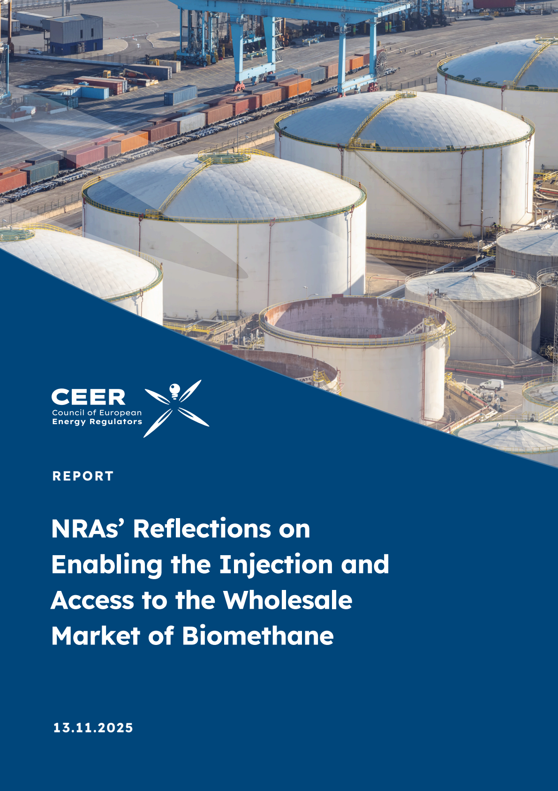
CEER Report on Biomethane
Case studies covering 9 countries
  Austria
  Belgium
  Czechia
  Denmark
  France
  Germany
  Italy
  Latvia
  Portugal

Slide 3
Report focuses on four areas
Access of biomethane to the wholesale market
Connection fees and costs for biomethane production facilities
Tariff discounts for biomethane
Trading of biomethane

Slide 4
Biomethane injection in the EU
The EU’s non-binding target of 35 bcm per year by 2030 seems unachievable
REPowerEU target
Source: European Biogas Association, Statistical Report 2025

Slide 5
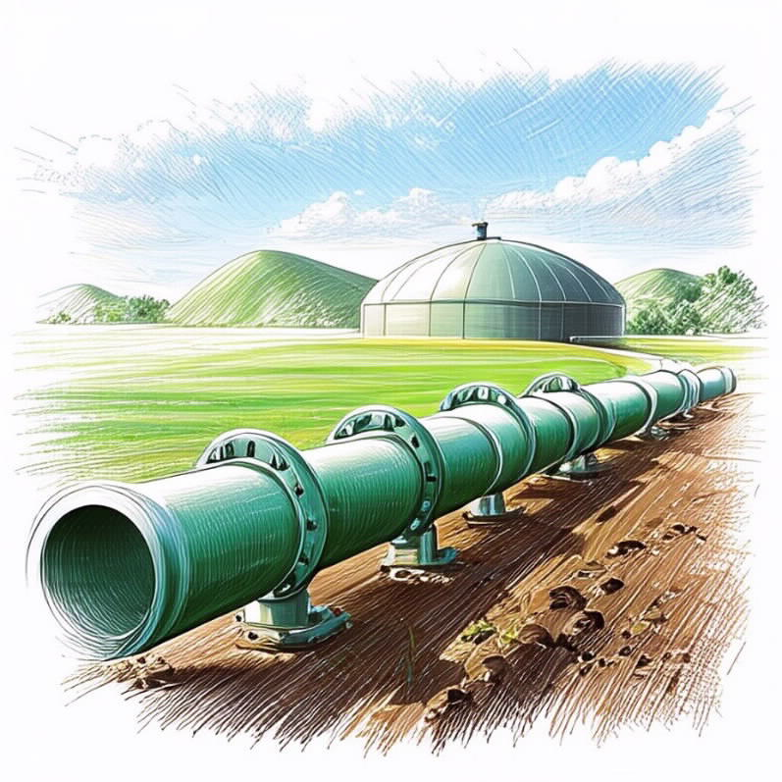
Connection costs for biomethane plants
Main finding: cost-sharing models are applied in most Member States…
… but different cost-sharing models exist
  DK, PT: producers cover most connection costs (pipelines, compressors, metering)
  AT, DE, FR, IT, LV, CZ producers pay part of project-specific costs:
    FR: 40% producer / 60% socialised (≤600k€)
    IT (DSO): 30% producer / 70% socialised
    DE: 25% producer / 75% operator (distance caps)
    CZ: case-specific (capacity & distance)
    LV: producer pays pipeline, TSO pays injection facilities
    AT: full socialisation if ≤60 m/m³CH₄eq/h
  System-level reinforcements (e.g. reverse flow)
    Usually covered by network operators and fully socialized
  Shared connection points for multiple plants can cut costs

Slide 6
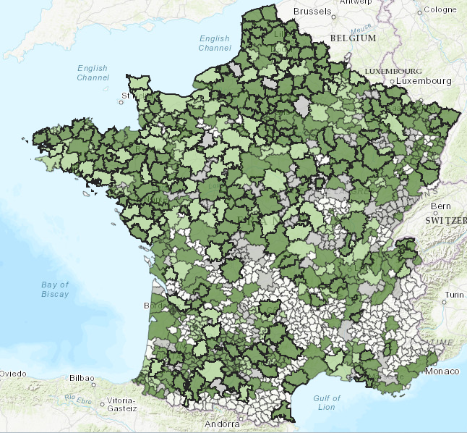
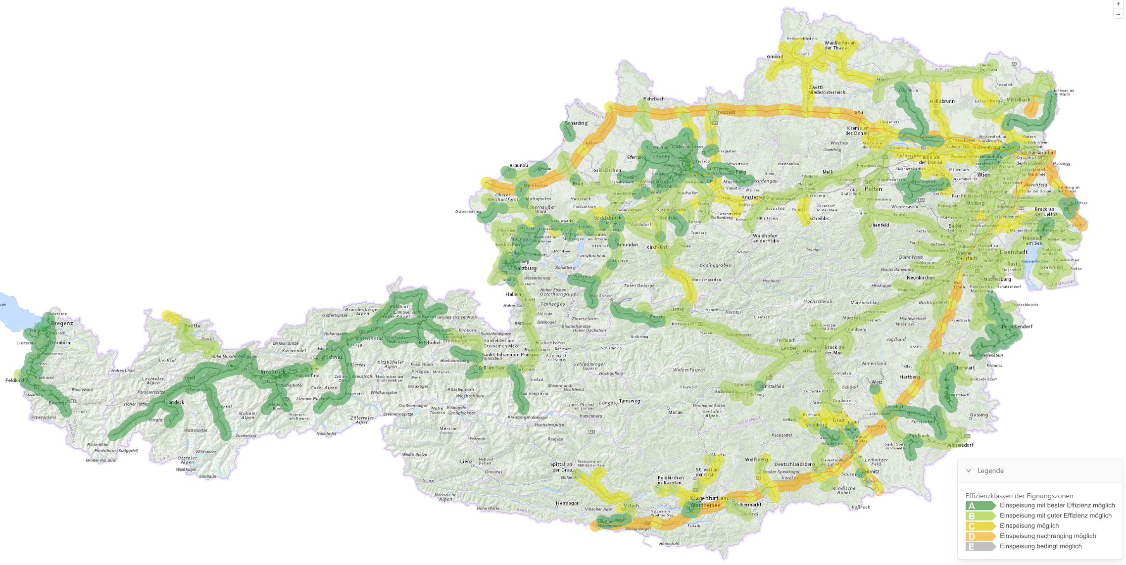
Mapping tools guide optimal injection points
Providing signals to biomethane project developers
Examples from Austria and France
Source: AGGM
Sources: NaTran and Teréga

Slide 7
Conclusion
Towards a well-functioning European biomethane market
The scale-up of the EU biomethane sector should primarily be supported through targeted public support schemes rather than regulated gas network tariffs
National implementation of the Decarbonisation Package should strike a balance between achieving EU decarbonisation targets and safeguarding the functioning of the internal energy market
Harmonised and interoperable approaches to gas certification schemes are essential to facilitate cross-border biomethane trade and market integration
Overall, greater coordination across Member States is key to unlocking the full potential of biomethane in the European energy market

